Slide 1
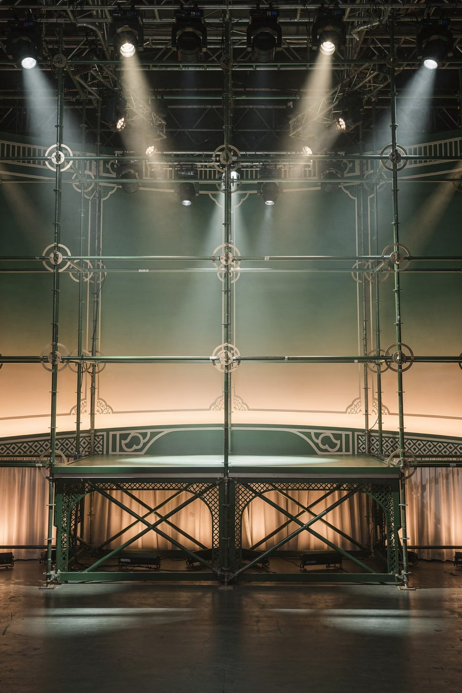
BUENOS RINGLOCKS
South India's Largest Ring Lock Scaffolding & Modular Staging Inventory
Engineered for Scale • Built for Safety • Trusted for Complexity

Slide 2
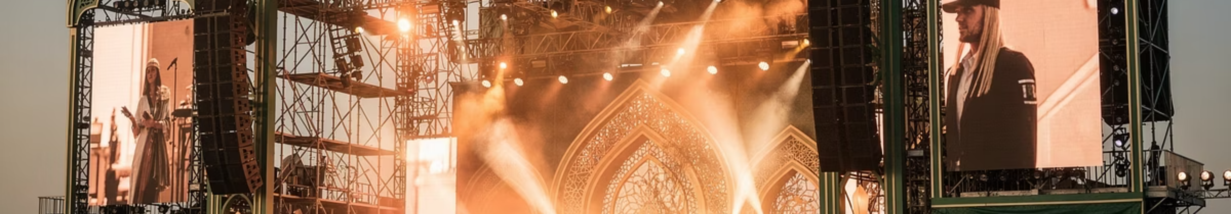
When Events Scale, Structures Decide Success
In today's large-format event landscape, structural integrity determines whether a production succeeds or fails. The most ambitious creative visions and innovative technical designs mean nothing if the underlying infrastructure cannot support them safely and efficiently.
Structural Limitations Kill Events
Safety, Speed, Load Are Non-Negotiable
Structure-Up, Not Afterthought
OTP builds events from the structure up, treating infrastructure as the primary engineering decision rather than a procurement afterthought.
Large-format events fail more often due to structural inadequacies than creative or technical shortcomings. The foundation must be right.
Modern event production demands rigorous safety standards, rapid deployment timelines, and precise load management capabilities without compromise.

Slide 3
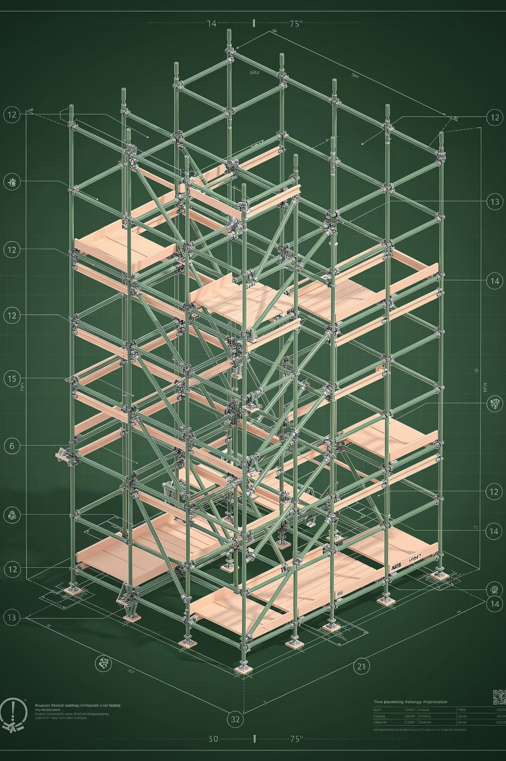



Structure-Led Production
At BUENOS, structure is not a vendor line item or support service. It is the core engineering decision that fundamentally determines safety parameters, project timelines, and scalability potential. Every production begins with structural integrity as the foundation upon which all other elements are built.
Engineering Precision
Load & Safety Assurance
Technical calculations, load analysis, and structural design executed with exacting standards
Comprehensive testing protocols and redundant safety systems across all installations
Speed of Execution
Rapid deployment capabilities without sacrificing quality or structural integrity

Slide 4
Owning Scale in South India
BUENOS now operates South India's largest Ring Lock Scaffolding & Modular Staging inventory, specifically designed and maintained for concerts, public events, exhibitions, and broadcast-scale productions across the region.
This infrastructure investment represents a fundamental shift in how large-format events can be executed across Tamil Nadu, Karnataka, Kerala, Andhra Pradesh, and Telangana. Where other providers rely on limited inventory or multi-source procurement, OTP delivers integrated, scalable solutions from a single point of accountability.
Our inventory depth enables simultaneous multi-city deployments, faster turnaround times, and the flexibility to handle last-minute scale changes that characterize modern event production environments.

Slide 5





Ring Lock Scaffolding System
122m
12m
8m
Maximum Width
Maximum Height
Maximum Depth
Unprecedented span capability for wide-format stages and structures
Vertical reach for FOH towers, facade structures, and elevated platforms
Substantial depth for complex rigging and multi-level configurations
Our modular aluminum Ring Lock system delivers high load-bearing capability with rapid assembly and dismantling characteristics. The system's engineering allows for clean geometry across wide spans while maintaining structural integrity under demanding load conditions.
Concert Stages
Facade Structures
FOH Towers
Exhibition Halls
Temporary Grandstands

Slide 6
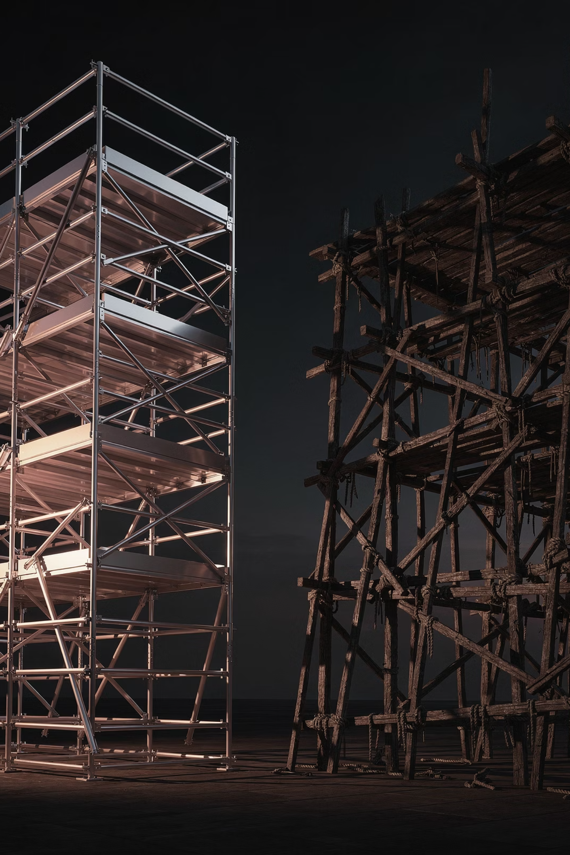




Why Ring Lock Over Conventional Systems
Ring Lock scaffolding represents a fundamental advancement in temporary structure technology. The system's engineering delivers measurable advantages in speed, safety, and structural performance compared to conventional scaffolding approaches.
Faster Build Cycles
Modular locking mechanism reduces assembly time by 30-40% compared to conventional pin-and-clip systems
Higher Load Tolerance
Enhanced load distribution and bearing capacity enables heavier rigging and equipment configurations
Cleaner Geometry
Precision-engineered components ensure true alignment across wide spans and complex configurations
Safety & Efficiency
Enhanced locking mechanism plus reduced manpower fatigue minimizes human error risk factors

Slide 7
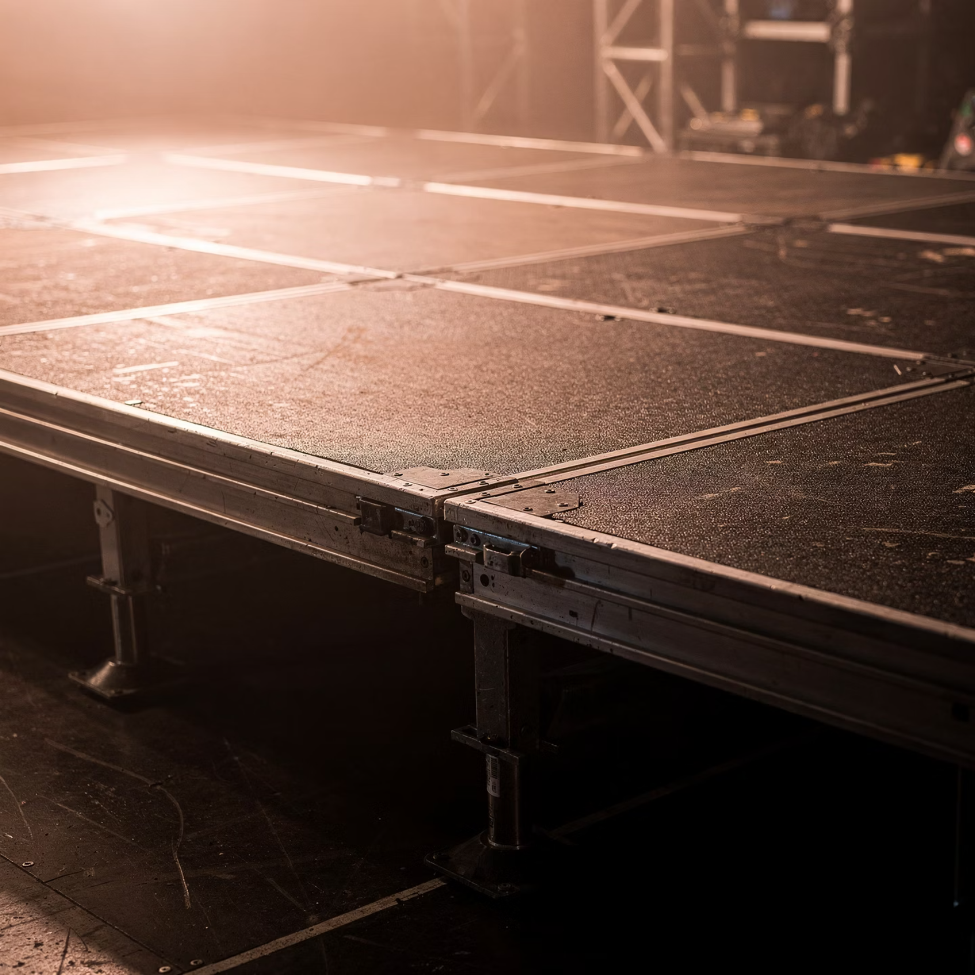
Professional Modular Staging
Technical Specifications
Our professional modular staging system provides concert-grade performance across diverse event formats. The system's flexibility allows for rapid configuration changes while maintaining structural precision and safety standards.
Stage Size: 30m × 20m maximum configuration
Height Options: 2m | 1.5m | 1m | 0.5m adjustable
Decking: Anti-skid, concert-grade weatherproof panels
Frames: Precision alignment with load-tested components
Integration: Compatible with standard rigging and lighting systems
The staging system's modular architecture enables configurations from intimate corporate presentations to large-scale concert platforms, with consistent safety characteristics across all deployment sizes.

Slide 8
Built for Public Safety & Regulatory Compliance
Public safety and regulatory compliance are not marketing claims at BUENOS—they are fundamental operational requirements embedded in every aspect of our structural systems and deployment protocols.
Load-Tested Components
Trained Assembly Teams
Every modular element undergoes rigorous load testing and certification before entering operational inventory. Testing protocols exceed industry standards and are documented for regulatory review.
Our technical teams complete comprehensive training programs covering assembly procedures, safety protocols, and emergency response. Continuous skill development ensures consistent execution quality.
Redundant Safety Systems
Government & PSU Ready
Multiple locking mechanisms, cross-bracing redundancy, and fail-safe design principles ensure structural integrity even under unexpected load conditions or equipment failures.
Our systems and documentation meet stringent requirements for government events, PSU functions, and regulated venues. Compliance is built-in, not retrofitted.

Slide 9





Designed for Complex Event Formats
BUENOS's structural systems are engineered to handle the diverse technical demands and operational complexities of modern large-format event production across multiple industries and audience types.
Live Concerts & Touring Shows
Political & Public Rallies
Exhibitions & Trade Expos
Full-scale stage infrastructure supporting international touring requirements, heavy rigging loads, and rapid build/strike schedules for multi-city tours.
Large-format platforms designed for crowd visibility, speaker protection, and media requirements in challenging outdoor environments with variable weather conditions.
Modular configurations supporting diverse booth heights, hanging loads, and circulation patterns across extended multi-day installation requirements.
Broadcast & Televised Events
Corporate & Government Conventions
Precision platforms accommodating camera positions, lighting grids, and technical infrastructure for professional broadcast production standards.
Professional staging solutions meeting corporate presentation requirements and government protocol standards with appropriate aesthetic refinement.

Slide 10
Execution at Scale
Operational capability separates infrastructure providers who own equipment from those who deliver reliable production outcomes. BUENOS's operational strength transforms inventory into executed events.
In-House Inventory
Faster Mobilization
Complete ownership eliminates third-party dependency, availability conflicts, and supply chain risk. Your event timeline is not subject to external vendor coordination challenges.
Direct control over equipment and logistics enables compressed deployment timelines. We respond to last-minute changes and accelerated schedules that eliminate conventional providers.
Experienced Leadership
Integrated Ecosystem
Our production and technical teams bring deep experience across diverse event formats. They anticipate challenges before they materialize and solve problems other teams do not recognize.
Structural systems integrate seamlessly with OTP's broader production capabilities—lighting, audio, video, power, and logistics—enabling coordinated execution across all technical disciplines.
The fundamental value proposition: Reliability exceeds availability. Equipment availability matters little if execution quality, timeline adherence, and problem-solving capability are absent.

Slide 11
More Than a Vendor. A Structural Partner.
BUENOS operates with a producer mindset, not a vendor mentality. We understand event production from the inside because our leadership has managed complex events, not just supplied equipment to them.
This perspective fundamentally changes how we approach client relationships and project execution.
Producer Mindset + Infrastructure Muscle
1
We think like producers while executing like infrastructure specialists. This combination is rare and valuable in large-format event environments.
2
Agency Experience Informs Execution
Years of agency-side production experience inform how we anticipate client needs, communicate proactively, and solve problems before they escalate.
Built for Demanding Environments
3
Our systems and processes are designed specifically for large, demanding, last-minute environments where conventional providers struggle or fail entirely.
4
Single Point of Accountability
One contact, one contract, one point of responsibility. No finger-pointing, no coordination nightmares, no excuses. We own outcomes, not just deliverables.

Slide 12
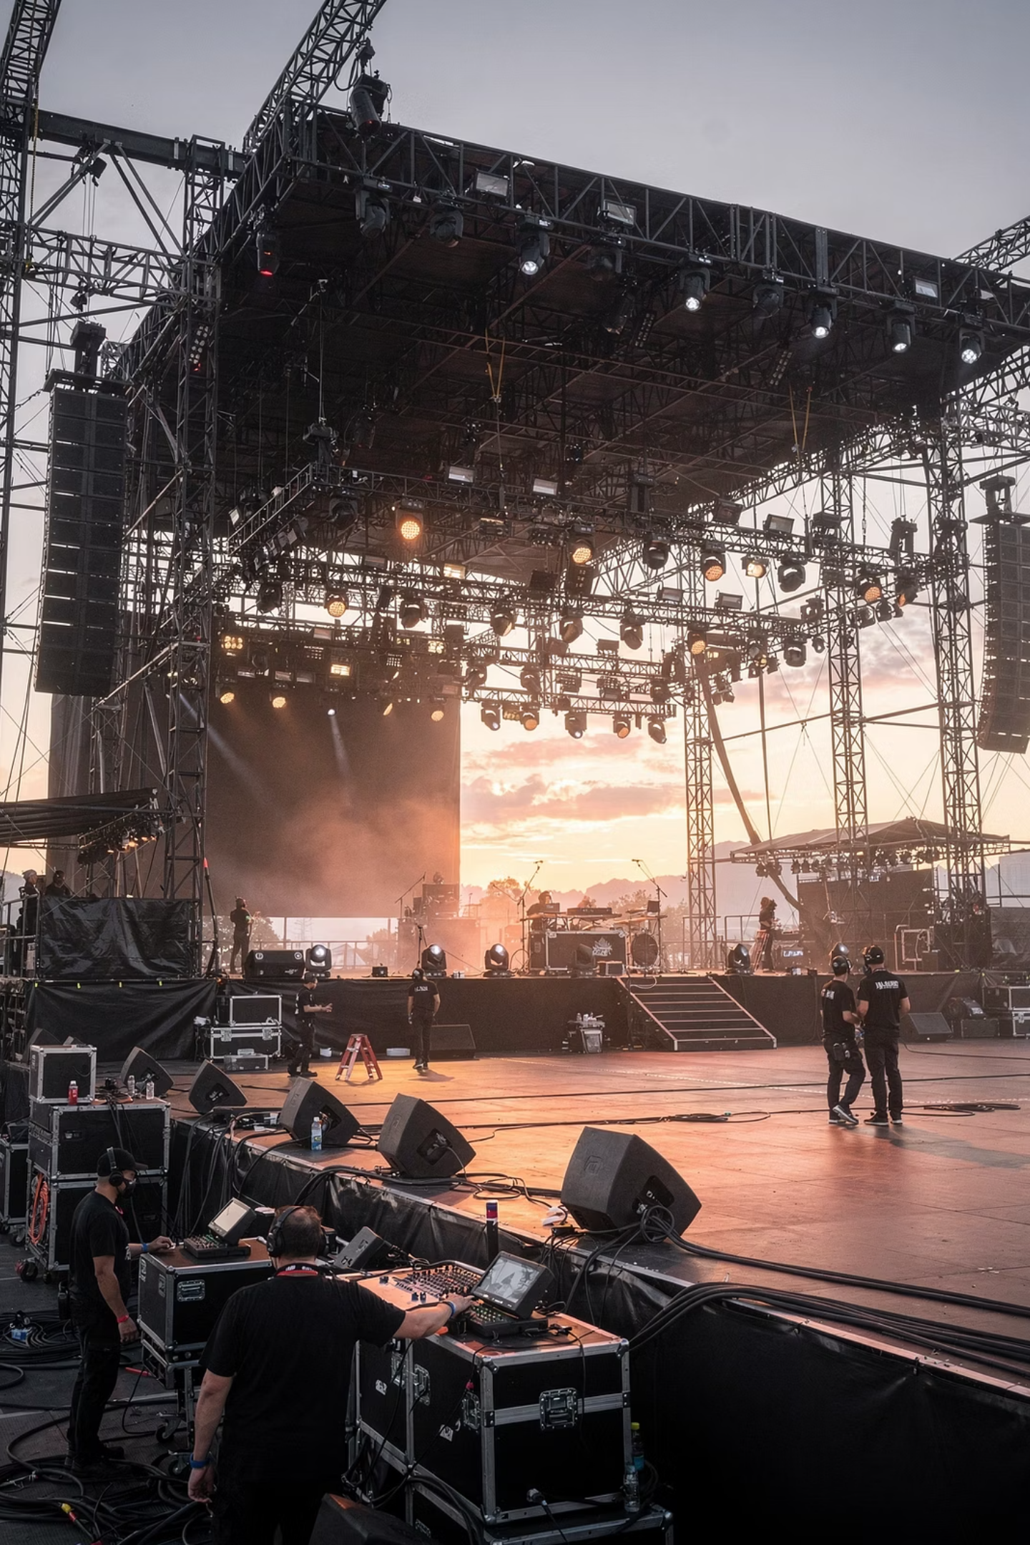
When Scale Matters, Structure First
The next time you plan a large-format event across South India, begin with the structural decision. Everything else follows from that foundation.
Planning a Large-Format Event?
Touring South India?
Multi-city production requiring consistent quality, rapid deployment, and reliable execution across diverse venues and conditions
Concert, rally, exhibition, or broadcast production requiring serious structural infrastructure and engineering precision
Need Speed Without Compromise?
Compressed timelines, last-minute changes, or challenging logistics requiring flexibility without sacrificing safety or structural integrity

Slide 13
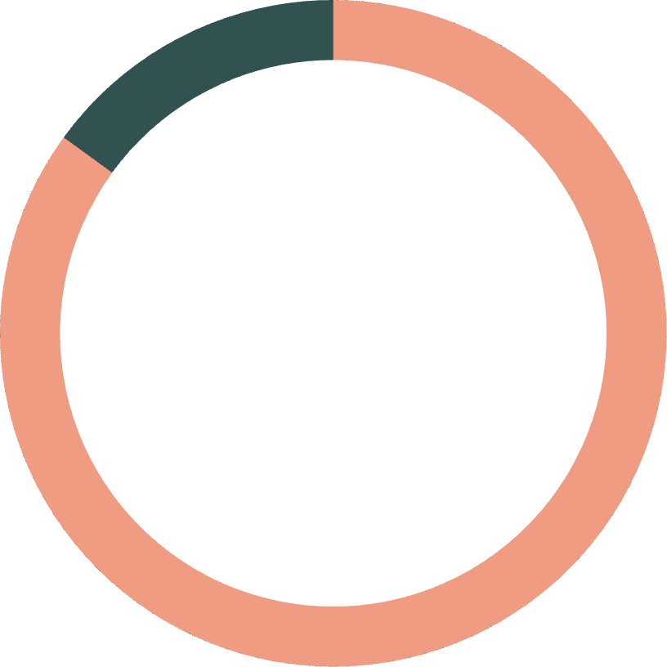
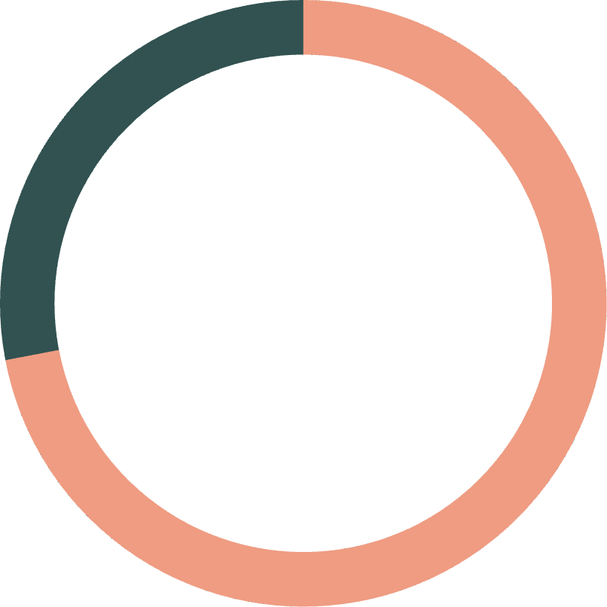

The BUENOS Inventory Advantage
Infrastructure depth matters. When event timelines compress, production scales unexpectedly, or multiple projects overlap, inventory capacity becomes the limiting factor for most structural providers. BUENOS's investment in South India's largest Ring Lock and modular staging inventory eliminates this constraint.
85%
72hrs
100%
Inventory Utilization Rate
Average Mobilization
In-House Ownership
Consistent deployment across simultaneous projects demonstrates real market demand and operational reliability
From confirmation to on-site deployment for standard large-format configurations across South India
Zero dependency on third-party rental networks or equipment brokers for structural components

Slide 14
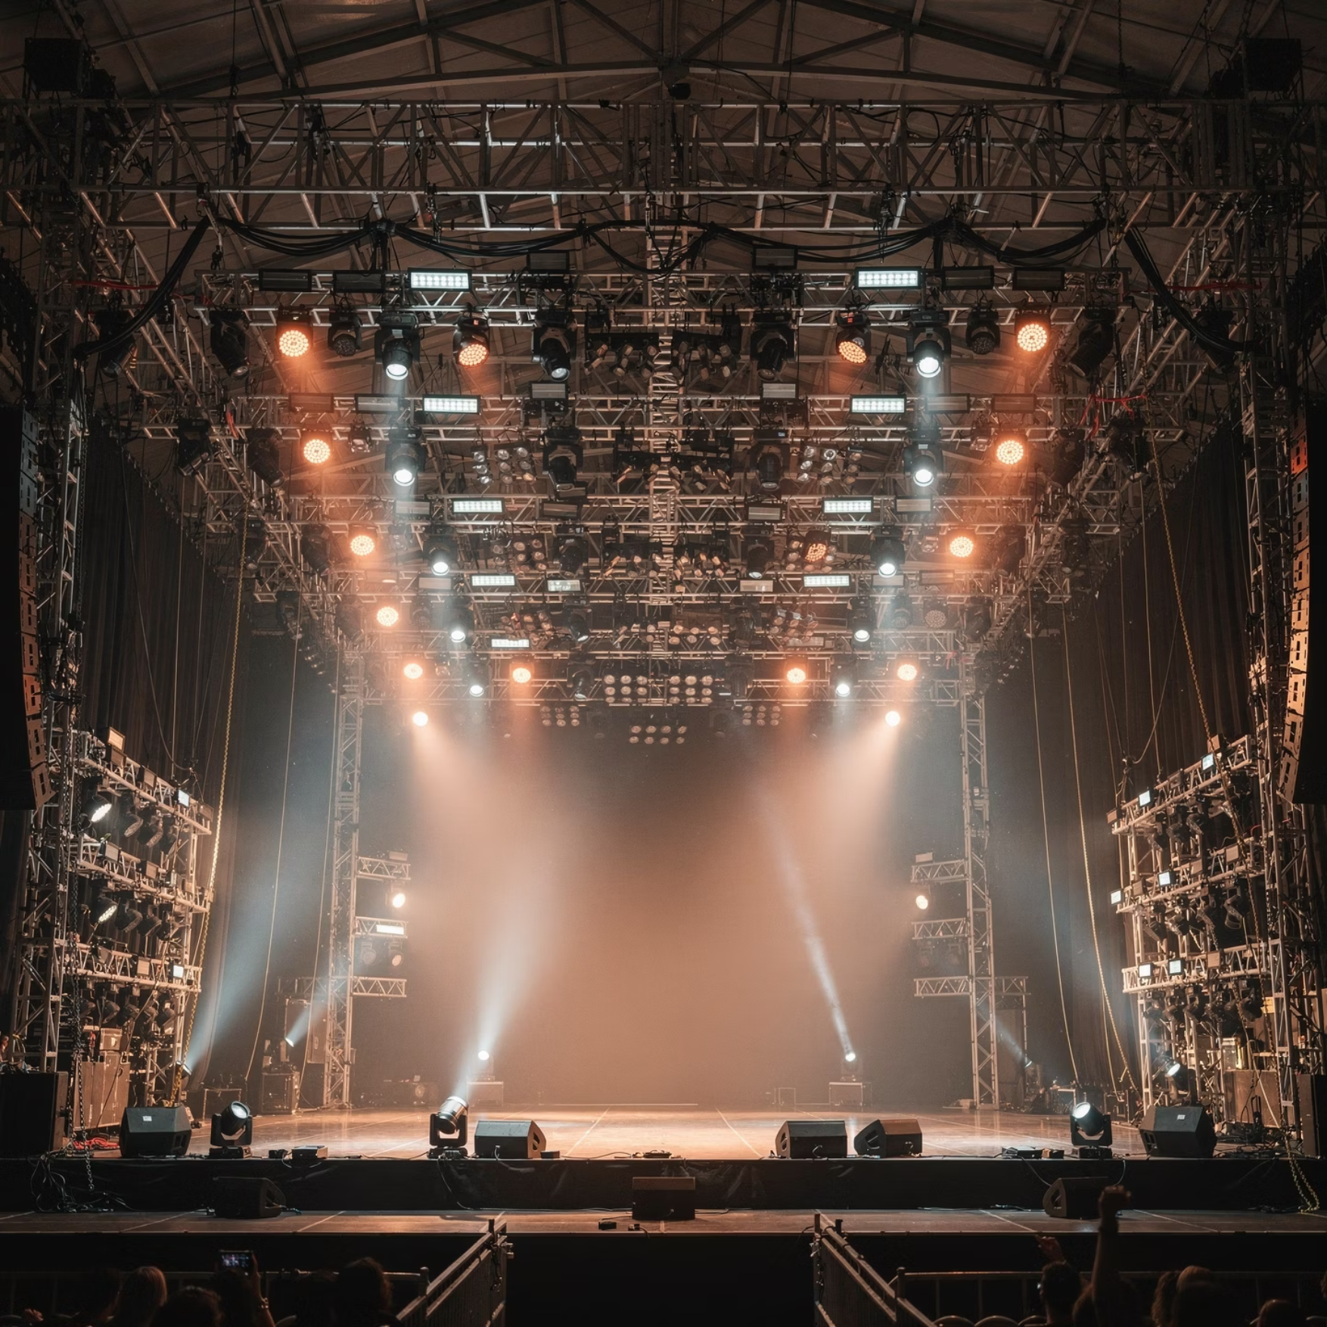
Technical Integration Capabilities
Modern event production requires seamless integration between structural systems and technical infrastructure. OTP's structural designs account for rigging loads, cable management, power distribution, and equipment mounting from the initial engineering phase.
Our teams coordinate directly with lighting designers, audio engineers, and video technicians to ensure structural solutions support rather than constrain technical ambitions.
01
02
Load Analysis
Structural Design
Calculate rigging points, equipment weights, and dynamic load factors
Engineer scaffold and staging configuration to accommodate technical requirements
03
04
Technical Coordination
Installation Oversight
Align with lighting, audio, video, and power teams on integration points
Deploy with technical supervision ensuring all disciplines work cohesively

Slide 15
Case Applications Across Event Types
BUENOS's structural systems have supported diverse event formats across South India, each with unique technical requirements and operational challenges. These applications demonstrate system versatility and execution reliability.
Multi-Day Music Festivals
State Political Rallies
Corporate Product Launches
Main stage, secondary stages, and FOH structures supporting international artist requirements across 3-day outdoor festival format with 50,000+ attendees.
Large-format platforms with crowd barriers, media positions, and security infrastructure for 100,000+ attendee political gatherings.
Refined staging with integrated AV, theatrical lighting support, and brand presentation infrastructure for high-profile corporate announcements.

Slide 16
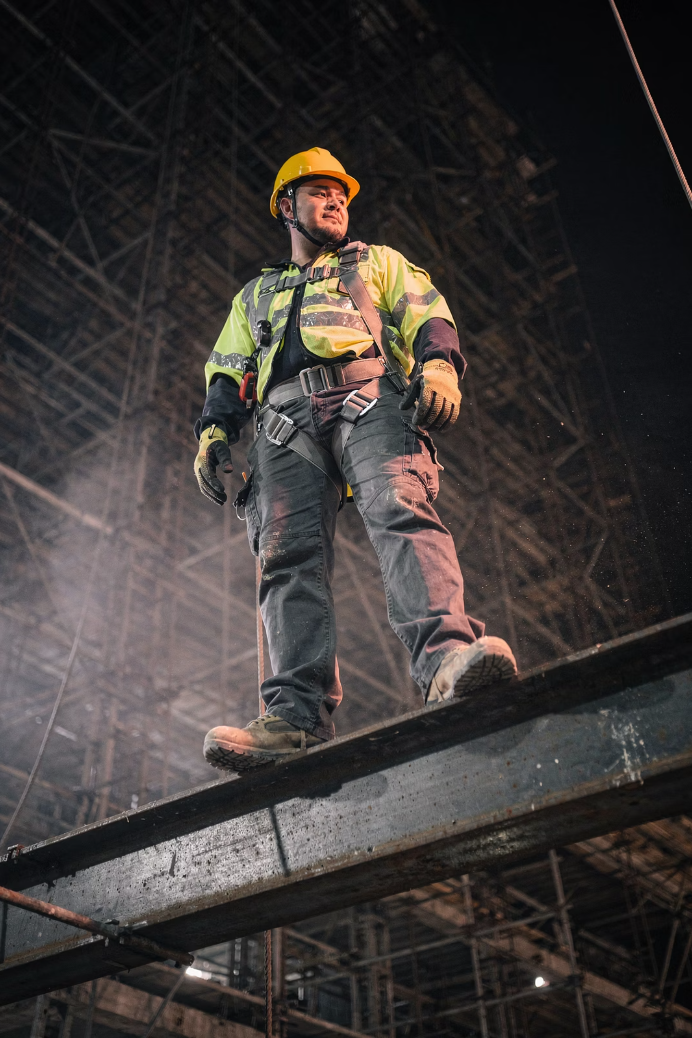




Safety Protocols & Risk Management
Structural safety is not achieved through equipment quality alone. BUENOS's safety framework encompasses equipment, procedures, training, supervision, and documentation across all deployment phases.
Pre-Deployment Inspection
Every component inspected for wear, damage, or defects before leaving inventory. Damaged elements are immediately removed from service.
Supervised Installation
Certified supervisors oversee all assembly operations, ensuring proper procedures, correct component selection, and adequate bracing.
Load Testing & Certification
Completed structures undergo load testing where required, with documentation provided for regulatory review and client records.
Event Monitoring
Technical supervisors remain on-site during events to monitor structural integrity and respond immediately to any emerging issues.

Slide 17

Regional Coverage & Logistics
South India's geographic diversity presents logistical challenges that many structural providers underestimate. BUENOS's operational footprint and logistics capabilities enable reliable service across the region's varied terrain and infrastructure conditions.
Logistics Capabilities
Primary Hub: Bangalore with optimized distribution across South India
Transport Fleet: Dedicated vehicles sized for scaffold and staging components
Route Planning: Expertise navigating challenging access conditions and permit requirements
Multi-City Coordination: Simultaneous deployment capability across multiple locations
Backup Systems: Redundant transportation and equipment backup for critical events
Our logistics network has successfully delivered to coastal venues, hill station locations, remote government complexes, and dense urban centers across Tamil Nadu, Karnataka, Kerala, Andhra Pradesh, and Telangana.

Slide 18
The Producer Partnership Model
BUENOS's relationship with event producers, production managers, and procurement teams differs fundamentally from transactional vendor relationships. We function as structural partners embedded in the production team rather than external suppliers.
Early Engagement
We engage during planning phases to inform structural decisions before designs are finalized. This prevents costly redesigns and ensures feasibility from the outset.
Proactive Communication
Our teams communicate potential issues, timeline impacts, and alternative solutions before problems materialize. No surprises, no hidden constraints revealed late in planning.
Flexible Problem-Solving
When inevitable changes occur—shifted timelines, modified scope, unexpected site conditions—we solve problems rather than cite contract limitations.
Post-Event Documentation
We provide comprehensive documentation including as-built drawings, load calculations, and safety certifications for your project archives and regulatory files.

Slide 19
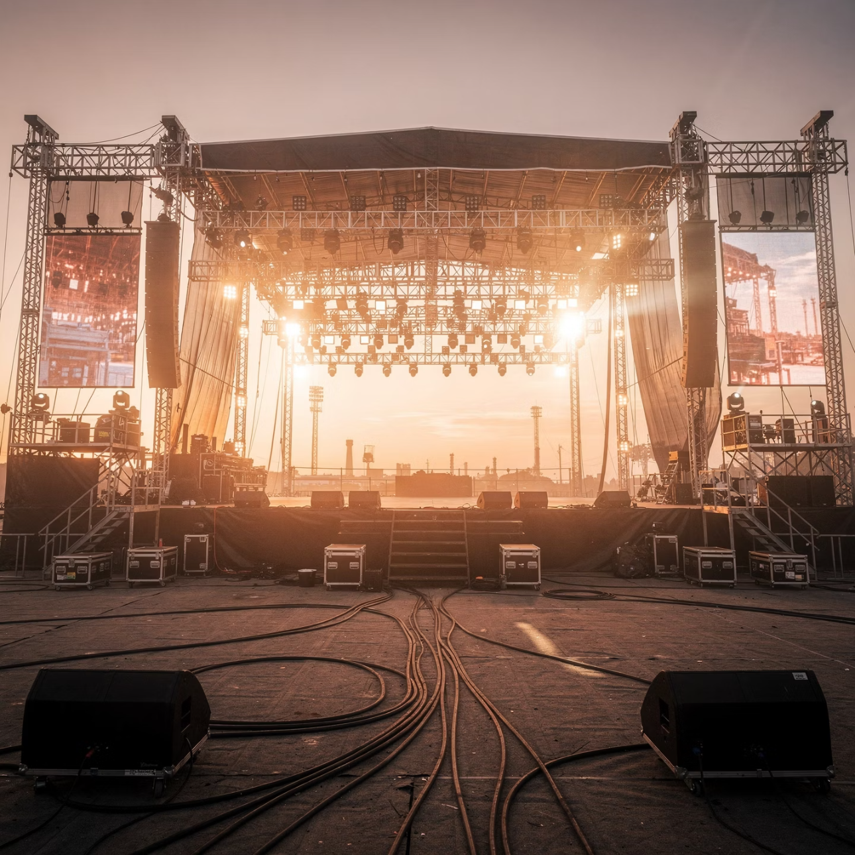

Begin with Structure
When your next large-format event demands structural infrastructure that delivers safety, speed, and scalability without compromise, begin the conversation with BUENOS Structures.
We bring South India's largest Ring Lock scaffolding and modular staging inventory, producer-level operational expertise, and a partnership approach that transforms structural infrastructure from a procurement challenge into a production advantage.
Contact OTP Structures™
Scaffolding & Modular Staging Division📍 Bangalore | Serving South India
peoduction@teambuenos.com
+91 9886103222
Structure First. Safety Always. Scale Without Limits.

